Slide 1
Poisson Regression

Slide 2
Predictive Models for “Count Data”

Slide 3
“Counting Data”
Positive Integer Target Variable: 0, 1, 2, 3, etc. (counting numbers)
The data follows either
“Poisson” Distribution
“Negative Binomial” Distribution

Slide 4
“Counting Numbers”
LINEAR REGRESSION Not usually a good choice because:
The relationship between INPUTS and TARGET are not linear
Linear Regression can yield a NEGATIVE prediction (Counts must be >0)
Errors distribution won’t be random (“heteroskedastic”)
INSTRUCTOR OPINION
Linear Regression is pretty simple to do and interpret. It can’t hurt to try a linear regression model and see how it performs.

Slide 5
Poisson Distribution

Slide 6
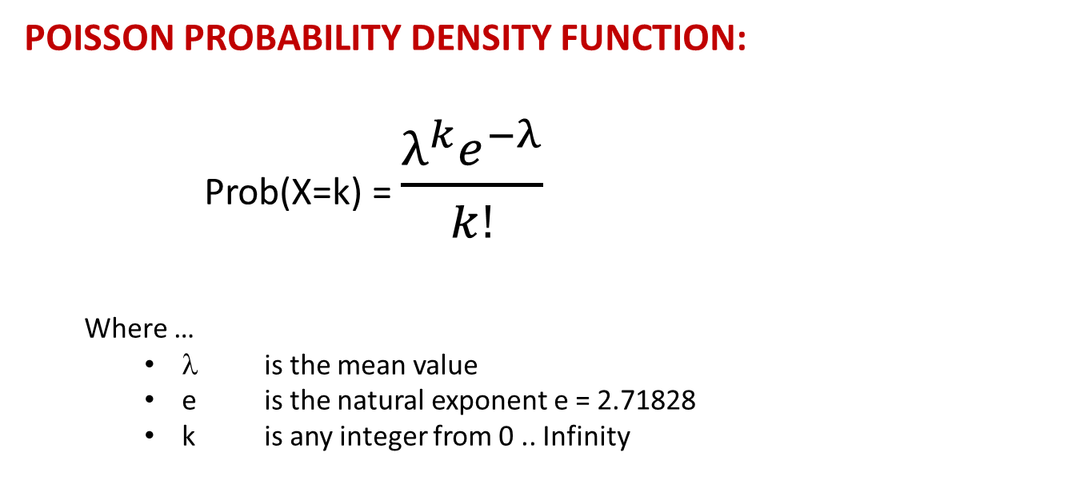
POISSON DISTRIBUTION
POISSON PROBABILITY DENSITY FUNCTION:
Prob(X=k) = $\frac{λ^{k}e^{−λ}}{k!}$
Where …
λ is the mean value
e is the natural exponent e = 2.71828
k is any integer from 0 .. Infinity

Slide 7
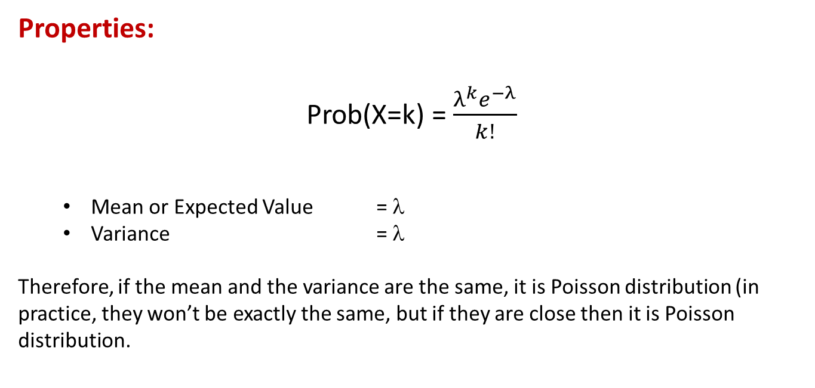
POISSON DISTRIBUTION
Properties:
Prob(X=k) = $\frac{λ^{k}e^{−λ}}{k!}$
Mean or Expected Value = λ
Variance = λ
Therefore, if the mean and the variance are the same, it is Poisson distribution (in practice, they won’t be exactly the same, but if they are close then it is Poisson distribution.

Slide 8
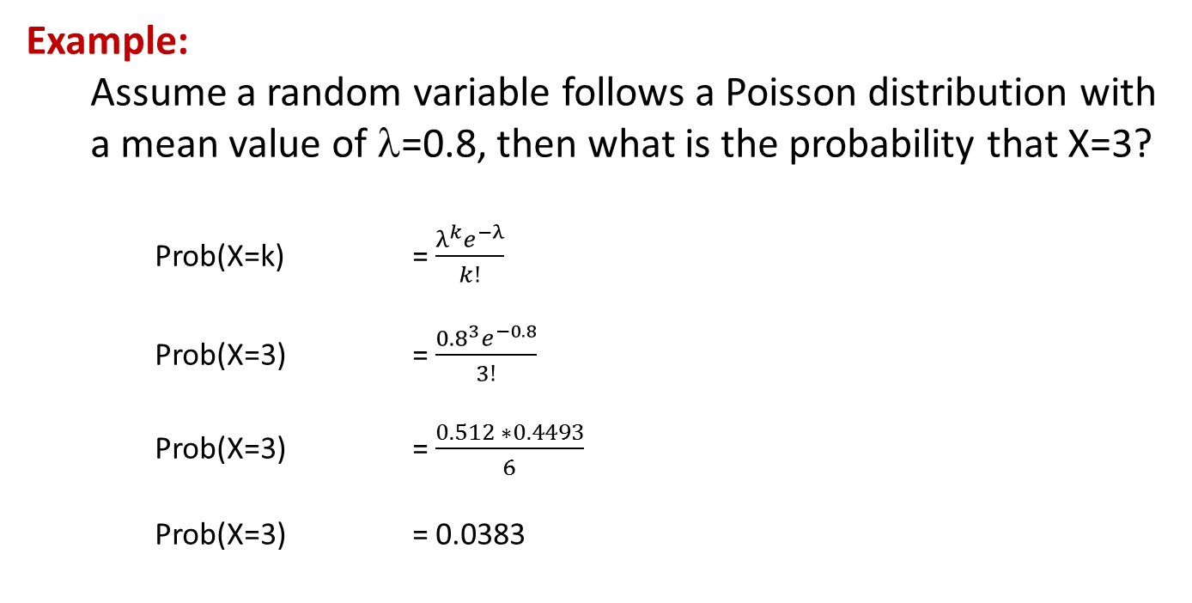
POISSON DISTRIBUTION
Example:
Assume a random variable follows a Poisson distribution with a mean value of λ=0.8, then what is the probability that X=3?
Prob(X=k) = $\frac{λ^{k}e^{−λ}}{k!}$
Prob(X=3) = $\frac{{0.8}^{3}e^{−0.8}}{3!}$
Prob(X=3) = $\frac{0.512 ∗0.4493}{6}$
Prob(X=3) = 0.0383

Slide 9
POISSON DISTRIBUTION
Example:
Assume a random variable follows a Poisson distribution with a mean value of λ=0.8, what are the probabilities of X=0..6?
K | Prob(x=K)
0 | 0.4493
1 | 0.3595
2 | 0.1438
3 | 0.0383
4 | 0.0077
5 | 0.0012
6 | 0.0002

Slide 10
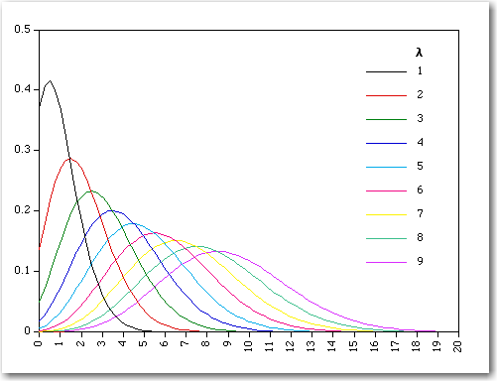
POISSON DISTRIBUTION
Graph:
This is a graph of the Poisson distribution of various values of λ.
Notice that as λ gets larger, Poisson distribution looks like Normal distribution

Slide 11
POISSON REGRESSION
Poisson Transform:
Recall that target variable can be transformed prior to regression:
LINEAR REGRESSION: G(y) = y (Identity or “Do Nothing”)
LOGISTIC REGRESSION: G(y) = ln( y/(1-y) ) (LOGIT Transform)
POISSON REGRESSION: G(Y) = ln( Y ) (Log Transform)
Note: Commercially available software will handle the possibility that Y=0 for Poisson Regression and Y=0 or 1 for Logistic Regression. For Poisson, for example, Y can be replaced by a small number greater than 0 or else add 1 to the target and subtract 1 after the regression. There are other techniques, but they are beyond the scope of this course. Suffice it to say that you don’t need to worry about this.

Slide 12
POISSON REGRESSION
After the G(Y) = ln(Y) transformation, the regression is conducted using Maximum Likelihood.
The result of the regression will be the NATURAL LOG of the Count, so the Count value must be determined by taking the INVERSE “ln” function. In other words exponentiate the output.

Slide 13
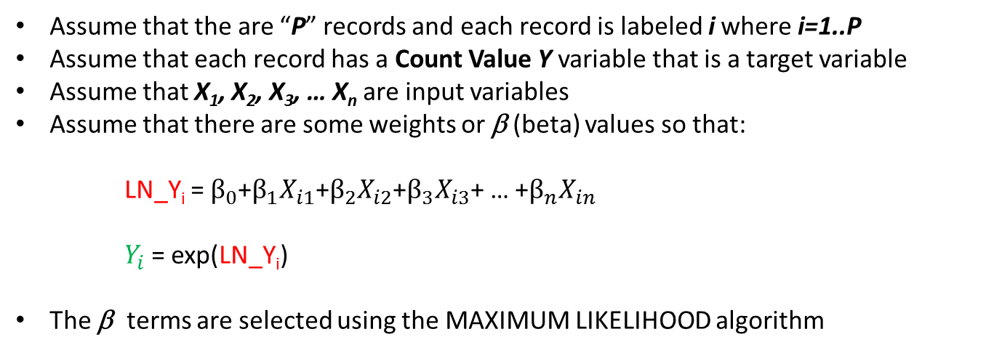
Poisson Regression Review
Assume that the are “P” records and each record is labeled i where i=1..P
Assume that each record has a Count Value Y variable that is a target variable
Assume that X₁, X₂, X₃, … X_{n} are input variables
Assume that there are some weights or β (beta) values so that:
LN_Y_{i} = $β_{0}$+$β_{1}X_{i1}\text{+}β_{2}X_{i2}$+$β_{3}X_{i3}$+ … +$β_{n}X_{in}$
$Y_{i}$= exp(LN_Y_{i})
The β terms are selected using the MAXIMUM LIKELIHOOD algorithm

Slide 14
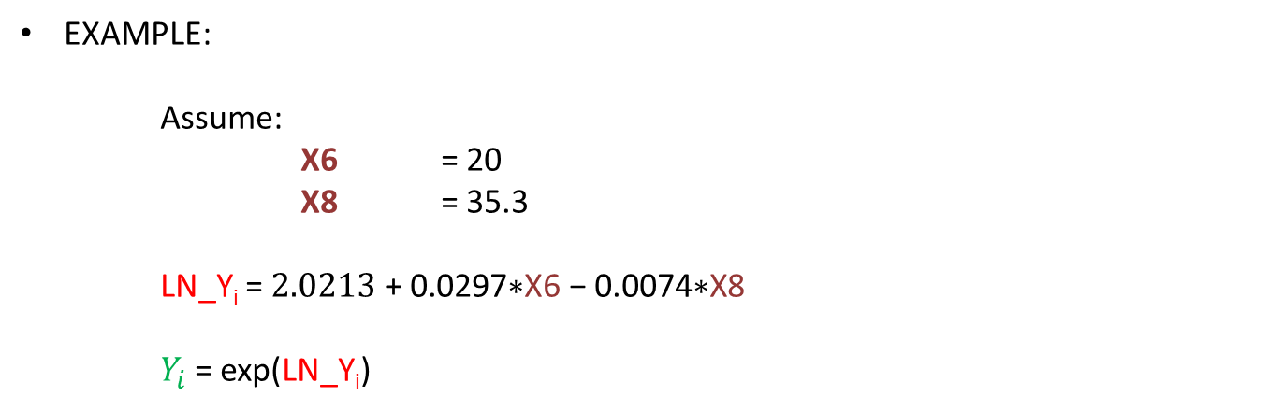
Poisson Regression Review
EXAMPLE:
Assume:
X6 = 20
X8 = 35.3
LN_Y_{i} = $2.0213\text{ + }\text{0.0297}\text{∗}\text{X}\text{6 − 0.0074∗}\text{X}\text{8}$
$Y_{i}$= exp(LN_Y_{i})

Slide 15
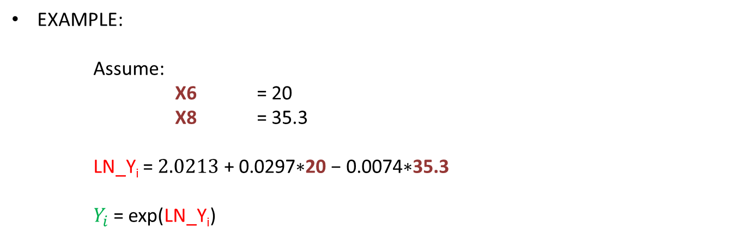
Poisson Regression Review
EXAMPLE:
Assume:
X6 = 20
X8 = 35.3
LN_Y_{i} = $2.0213\text{ + }\text{0.0297}\text{∗}\text{20} \text{− }\text{0.0074}\text{∗}\text{35.3}$
$Y_{i}$= exp(LN_Y_{i})

Slide 16
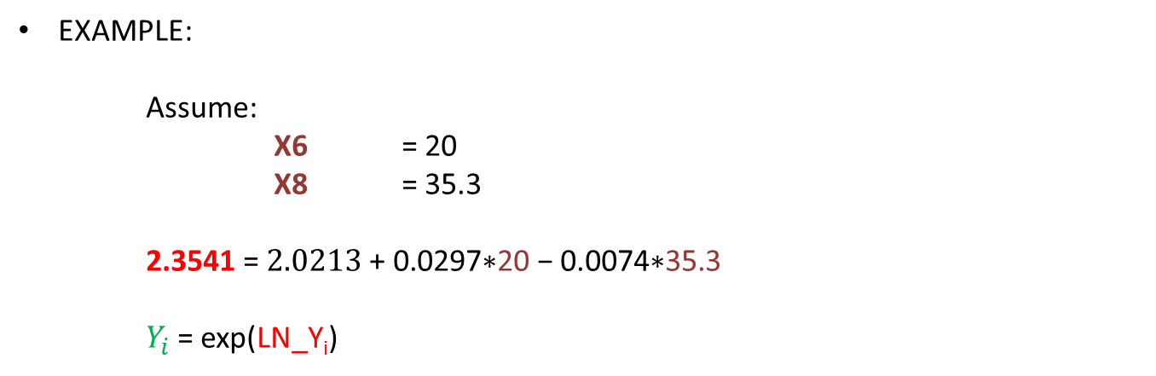
Poisson Regression Review
EXAMPLE:
Assume:
X6 = 20
X8 = 35.3
2.3541 = $2.0213\text{ + }\text{0.0297}\text{∗}\text{20} \text{− }\text{0.0074}\text{∗}\text{35.3}$
$Y_{i}$= exp(LN_Y_{i})

Slide 17
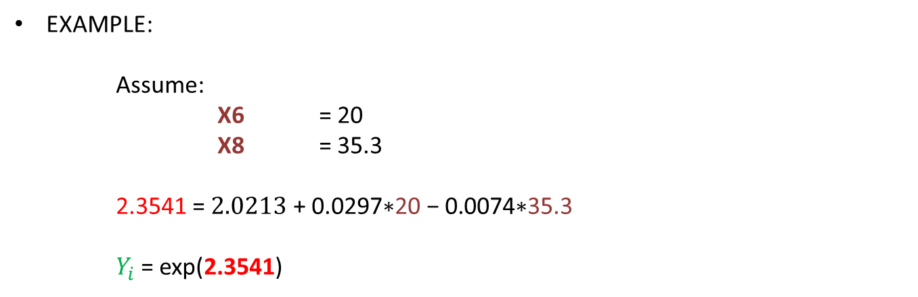
Poisson Regression Review
EXAMPLE:
Assume:
X6 = 20
X8 = 35.3
2.3541 = $2.0213\text{ + }\text{0.0297}\text{∗}\text{20} \text{− }\text{0.0074}\text{∗}\text{35.3}$
$Y_{i}$= exp(2.3541)

Slide 18
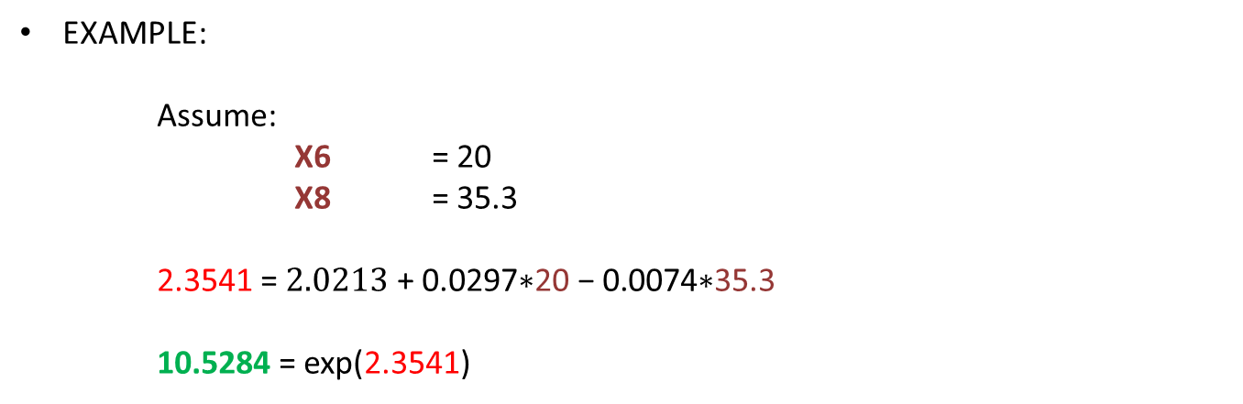
Poisson Regression Review
EXAMPLE:
Assume:
X6 = 20
X8 = 35.3
2.3541 = $2.0213\text{ + }\text{0.0297}\text{∗}\text{20} \text{− }\text{0.0074}\text{∗}\text{35.3}$
10.5284 = exp(2.3541)

Slide 19
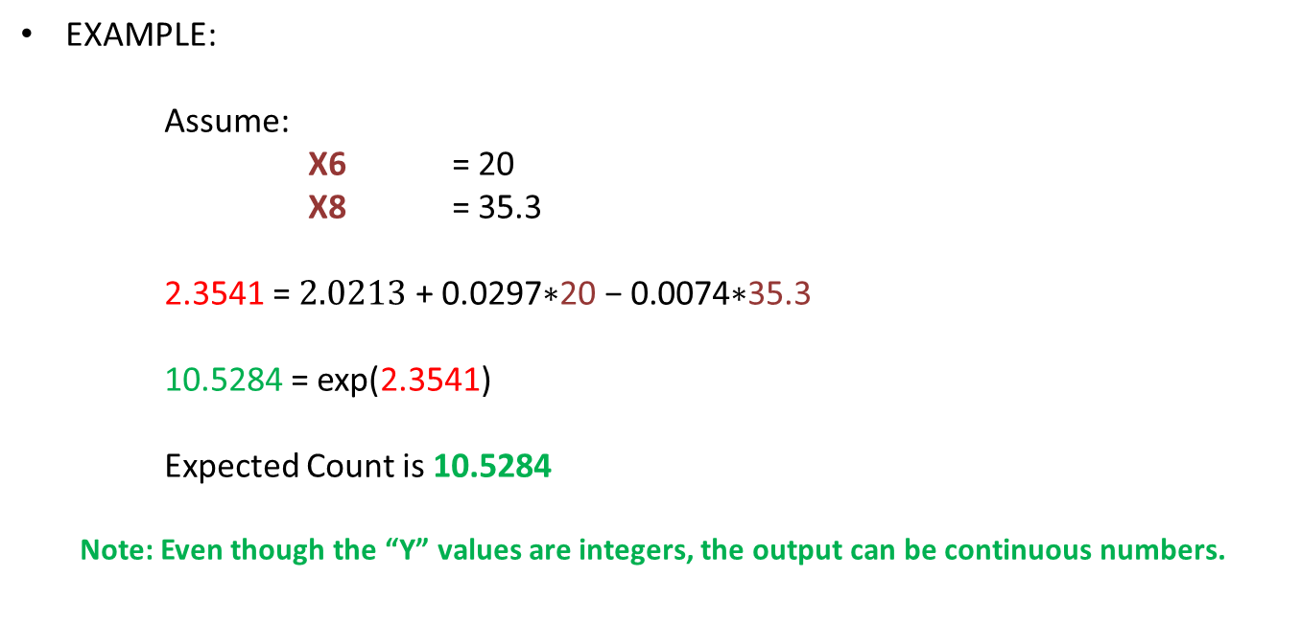
Poisson Regression Review
EXAMPLE:
Assume:
X6 = 20
X8 = 35.3
2.3541 = $2.0213\text{ + }\text{0.0297}\text{∗}\text{20} \text{− }\text{0.0074}\text{∗}\text{35.3}$
10.5284 = exp(2.3541)
Expected Count is 10.5284
Note: Even though the “Y” values are integers, the output can be continuous numbers.

Slide 20
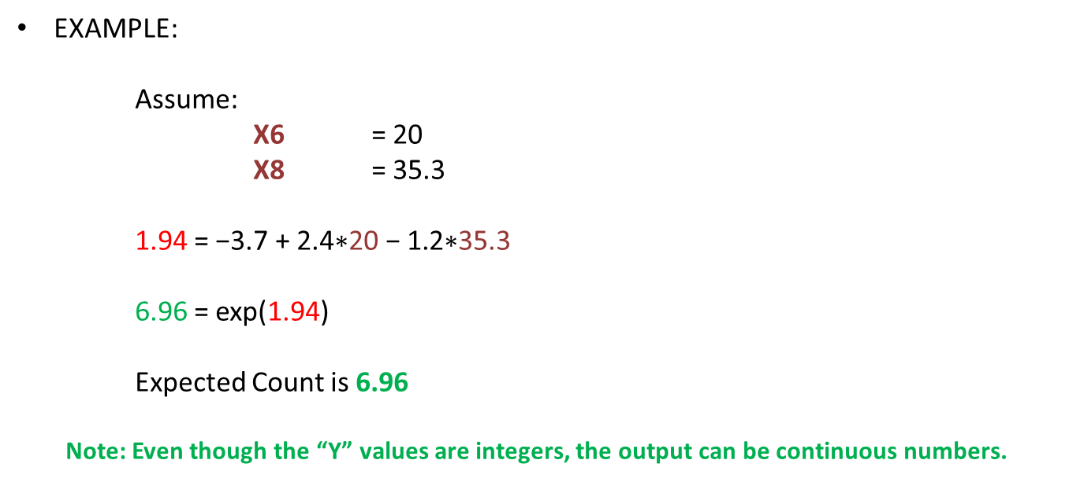
Poisson Regression Review
EXAMPLE:
Assume:
X6 = 20
X8 = 35.3
1.94 = $\text{−3.}\text{7}\text{ + 2.}\text{4}\text{∗}\text{20} \text{− }\text{1.2}\text{∗}\text{35.3}$
6.96 = exp(1.94)
Expected Count is 6.96
Note: Even though the “Y” values are integers, the output can be continuous numbers.

Slide 21
Negative Binomial Distribution

Slide 22
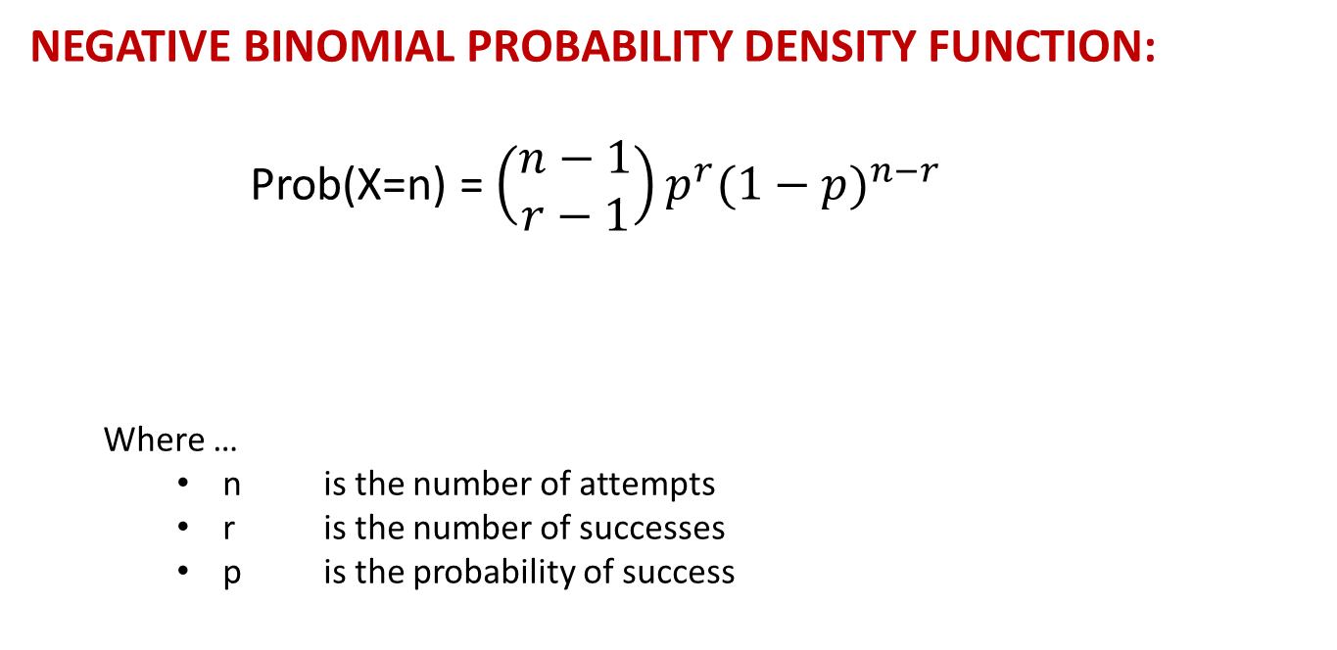
NEGATIVE BINOMIAL DISTRIBUTION
NEGATIVE BINOMIAL PROBABILITY DENSITY FUNCTION:
Prob(X=n) = $\left(\begin{matrix}n−1 \\ r−1\end{matrix}\right)p^{r}{(1−p)}^{n−r}$
Where …
n is the number of attempts
r is the number of successes
p is the probability of success

Slide 23
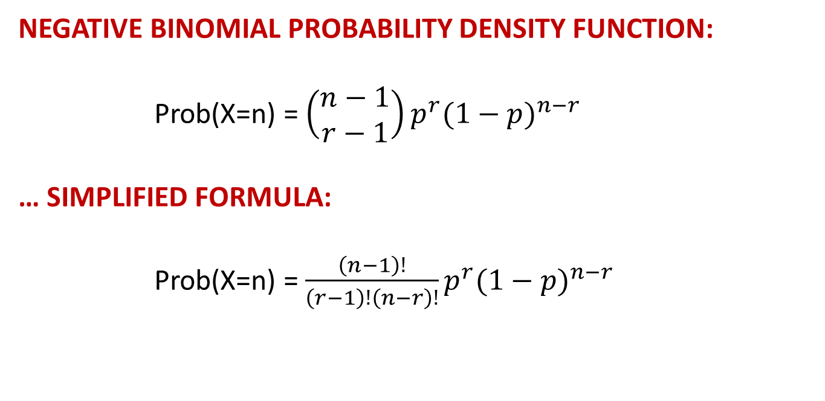
NEGATIVE BINOMIAL DISTRIBUTION
NEGATIVE BINOMIAL PROBABILITY DENSITY FUNCTION:
Prob(X=n) = $\left(\begin{matrix}n−1 \\ r−1\end{matrix}\right)p^{r}{(1−p)}^{n−r}$
… SIMPLIFIED FORMULA:
Prob(X=n) = $\frac{\left(n−1\right)!}{\left(r−1\right)!\left(n−r\right)!}p^{r}{(1−p)}^{n−r}$

Slide 24
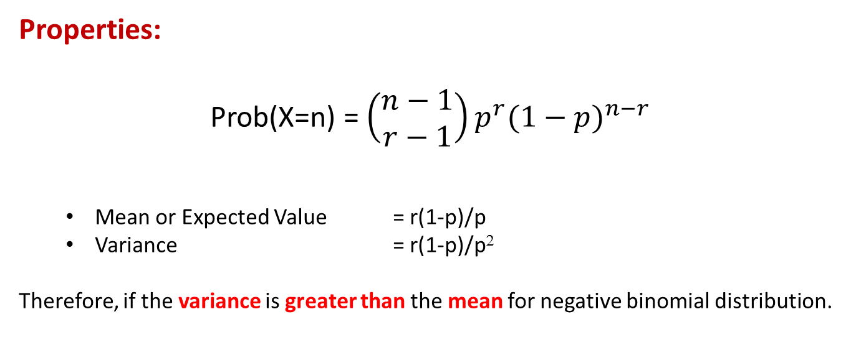
NEGATIVE BINOMIAL DISTRIBUTION
Properties:
Prob(X=n) = $\left(\begin{matrix}n−1 \\ r−1\end{matrix}\right)p^{r}{(1−p)}^{n−r}$
Mean or Expected Value = r(1-p)/p
Variance = r(1-p)/p²
Therefore, if the variance is greater than the mean for negative binomial distribution.

Slide 25
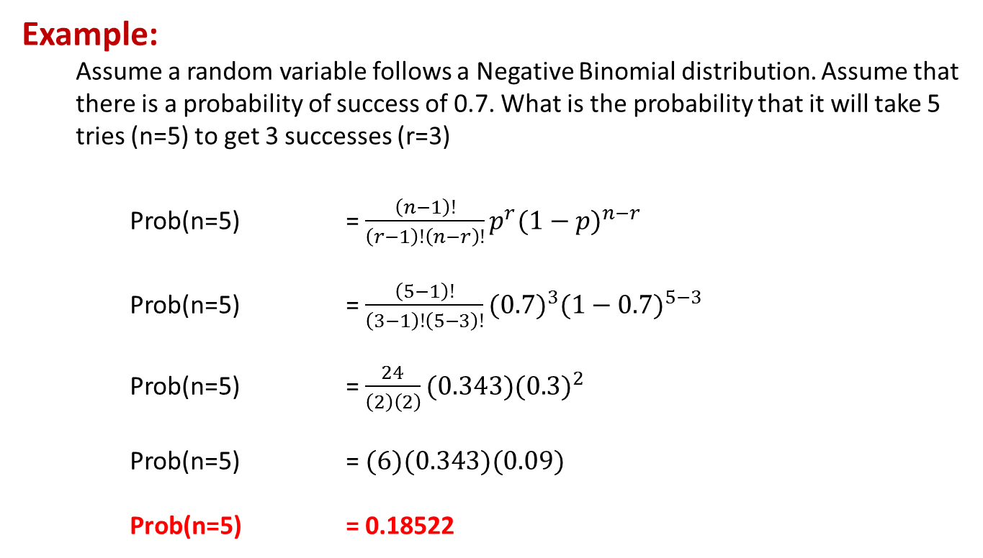
NEGATIVE BINOMIAL DISTRIBUTION
Example:
Assume a random variable follows a Negative Binomial distribution. Assume that there is a probability of success of 0.7. What is the probability that it will take 5 tries (n=5) to get 3 successes (r=3)
Prob(n=5) = $\frac{\left(n−1\right)!}{\left(r−1\right)!\left(n−r\right)!}p^{r}{(1−p)}^{n−r}$
Prob(n=5) = $\frac{\left(5−1\right)!}{\left(3−1\right)!\left(5−3\right)!}{(0.7)}^{3}{(1−0.7)}^{5−3}$
Prob(n=5) = $\frac{24}{\left(2\right)\left(2\right)}(0.343){(0.3)}^{2}$
Prob(n=5) = $(6)(0.343)(0.09)$
Prob(n=5) = 0.18522

Slide 26
NEGATIVE BINOMIAL DISTRIBUTION
Example:
Assume a random variable follows a Negative Binomial distribution with a probability of success of 0.7. What is the probability of that there will be “N” trials to achieve r=3 successes.
N | Prob(x=N)
3 | 0.343
4 | 0.309
5 | 0.185
6 | 0.093
7 | 0.042
8 | 0.018
9 | 0.007

Slide 27
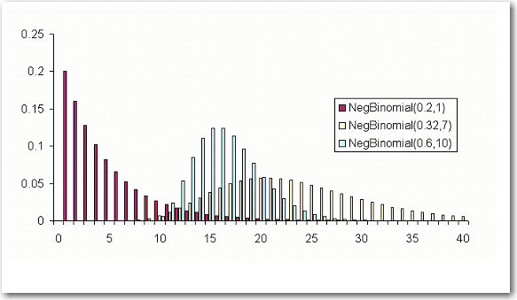
NEGATIVE BINOMIAL DISTRIBUTION
Graph:
This is a graph of the Negative Binomial distribution of various values of p and r.

Slide 28
NEGATIVE BINOMIAL REGRESSION
Negative Binomial Transform:
The Negative Binomial Transform is similar to Poisson Regression in that it uses the natural log transformation.
LINEAR REGRESSION: G(y) = y (Identity or “Do Nothing”)
LOGISTIC REGRESSION: G(y) = ln( y/(1-y) ) (LOGIT Transform)
POISSON REGRESSION: G(Y) = ln( Y ) (Log Transform)
NEGATIVE BINOMIAL REGRESSION: G(Y) = ln( Y ) (Log Transform)
Note: Poisson Regression is actually a special case of Negative Binomial Regression where the mean and the variance are equal. Many times, if the variance and the mean are similar, both Poisson and Negative Binomial Regressions will converge to the same result.

Slide 29
Poisson Regression
Example

Slide 30
Poisson Regression: Example
This example is taken from the previously mentioned Draper and Smith reference.
The data describes monthly steam usage in a manufacturing plant
YTEMP Monthly use of steam
Y round(YTEMP,1) Note: rounding YTEMP to the nearest “1” value
X6 Operating days per month
X8 Average temperature in degrees Fahrenheit
NOTE: Draper and Smith named their variables X6 and X8, don’t worry about that. The names of the variables are not important and don’t affect the formula.
Raw Data is given on the following slide.
SAS Code is provided to read data into SAS

Slide 31
Poisson Regression: Example
Raw Steam Usage Data
 | X6 | X8 | Y
1 | 20 | 35.3 | 10.98
2 | 20 | 29.7 | 11.13
3 | 23 | 30.8 | 12.51
4 | 20 | 58.8 | 8.4
5 | 21 | 61.4 | 9.27
6 | 22 | 71.3 | 8.73
7 | 11 | 74.4 | 6.36
8 | 23 | 76.7 | 8.5
9 | 21 | 70.7 | 7.82
10 | 20 | 57.5 | 9.14
11 | 20 | 46.4 | 8.24
12 | 21 | 28.9 | 12.19
13 | 21 | 28.1 | 11.88
14 | 19 | 39.1 | 9.57
15 | 23 | 46.8 | 10.94
16 | 20 | 48.5 | 9.58
17 | 22 | 59.3 | 10.09
18 | 22 | 70 | 8.11
19 | 11 | 70 | 6.83
20 | 23 | 74.5 | 8.88
21 | 20 | 72.1 | 7.68
22 | 21 | 58.1 | 8.47
23 | 20 | 44.6 | 8.86
24 | 20 | 33.4 | 10.36
25 | 22 | 28.6 | 11.08

Slide 32
Poisson Regression: Example
SAS Data Step to read in raw data
data TEMPFILE;
input X6 X8 YTEMP;
Y = round(YTEMP,1);
drop YTEMP;
datalines;
20 35.3 10.98
20 29.7 11.13
23 30.8 12.51
20 58.8 8.40
21 61.4 9.27
22 71.3 8.73
11 74.4 6.36
23 76.7 8.50
21 70.7 7.82
20 57.5 9.14
20 46.4 8.24
21 28.9 12.19
21 28.1 11.88
19 39.1 9.57
23 46.8 10.94
20 48.5 9.58
22 59.3 10.09
22 70.0 8.11
11 70.0 6.83
23 74.5 8.88
20 72.1 7.68
21 58.1 8.47
20 44.6 8.86
20 33.4 10.36
22 28.6 11.08
;
run;

Slide 33
Poisson Regression: Example
NOTE: In the SAS data step, the Y = round(YTEMP,1); command will return an integer value of YTEMP rounded to the nearest “1” value.
data TEMPFILE;
input X6 X8 YTEMP;
Y = round(YTEMP,1);
drop YTEMP;
datalines;
20 35.3 10.98
20 29.7 11.13
23 30.8 12.51
20 58.8 8.40
61.4 9.27
...

Slide 34
Poisson Regression: Example
After the data has been read in and transformed, the data set looks like this:
 | X6 | X8 | Y
1 | 20 | 35.3 | 11
2 | 20 | 29.7 | 11
3 | 23 | 30.8 | 13
4 | 20 | 58.8 | 8
5 | 21 | 61.4 | 9
6 | 22 | 71.3 | 9
7 | 11 | 74.4 | 6
8 | 23 | 76.7 | 9
9 | 21 | 70.7 | 8
10 | 20 | 57.5 | 9
11 | 20 | 46.4 | 8
12 | 21 | 28.9 | 12
13 | 21 | 28.1 | 12
14 | 19 | 39.1 | 10
15 | 23 | 46.8 | 11
16 | 20 | 48.5 | 10
17 | 22 | 59.3 | 10
18 | 22 | 70 | 8
19 | 11 | 70 | 7
20 | 23 | 74.5 | 9
21 | 20 | 72.1 | 8
22 | 21 | 58.1 | 8
23 | 20 | 44.6 | 9
24 | 20 | 33.4 | 10
25 | 22 | 28.6 | 11

Slide 35
Poisson Regression: Example
Before doing a regression, it is usually a good idea to do some analysis on the data to determine the distribution of the data, the mean, and the variance. Many procs can do this, some of the more simple approaches are:
proc means data=TEMPFILE MEAN VAR;
var Y;
run;
proc univariate data=TEMPFILE noprint;
histogram Y;
run;

Slide 36
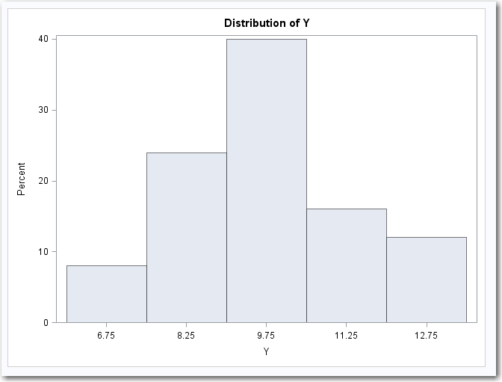
Poisson Regression: Example
The output from the Univariate proc is given below. The bar chart shows that the distribution could be Poisson or Negative Binomial. The data seems to follow a normal distribution which is a special case of Poisson or NB. There are no spikes at any value, such as 0 which might suggest using a Zero Inflated Model (more on that later).

Slide 37
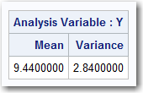
Poisson Regression: Example
Continuing with the analysis, it is seen from the PROC MEANS that the variance is smaller than the mean. From this, we can conclude that this data does not actually fit a Poisson distribution or a Negative Binomial distribution. These distributions require that the variance be equal to the mean for Poisson and greater than the mean for Negative Binomial.
Even though this is not technically Poisson or NB, the analysis will continue for demonstration purposes. Also, distinguished statistician John Tukey taught that statistics are robust and can give good results even when assumptions are violated.

Slide 38
Poisson Regression: Example
SAS has several procs that can handle counting numbers. The three procs used are:
PROC REG (standard regression should always be tried, it’s easy and can work well)
PROC GENMOD with POISSON (“poi”) distribution
PROC GENMOD with NEGATIVE BINOMIAL (“nb”) distribution
proc reg data=TEMPFILE;
model Y = X6 X8;
output out=TEMPFILE p=Y_REG;
run;
quit;
proc genmod data=TEMPFILE;
model Y = X6 X8 /link=log dist=poi;
output out=TEMPFILE p=Y_POI;
run;
proc genmod data=TEMPFILE;
model Y = X6 X8 /link=log dist=nb;
output out=TEMPFILE p=Y_NB;
run;

Slide 39
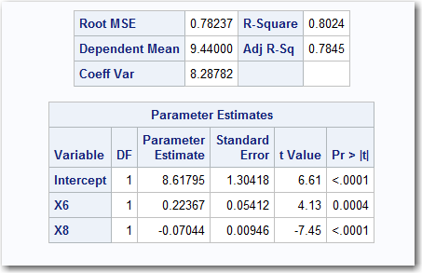
Poisson Regression: Example
PROC REG:
proc reg data=TEMPFILE;
model Y = X6 X8;
output out=TEMPFILE p=Y_REG;
run; quit;
Beta Values

Slide 40
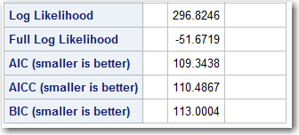
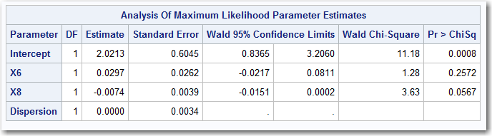
Poisson Regression: Example
PROC GENMOD … POISSON DISTRIBUTION:
proc genmod data=TEMPFILE;
model Y = X6 X8 /link=log dist=poi;
output out=TEMPFILE p=Y_POI;
run;
Error Terms
Beta Values

Slide 41
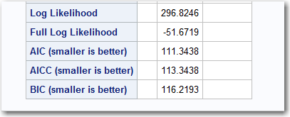
Poisson Regression: Example
PROC GENMOD … NEGATIVE BINOMIAL DISTRIBUTION:
proc genmod data=TEMPFILE;
model Y = X6 X8 /link=log dist=nb;
output out=TEMPFILE p=Y_NB;
run;
Error Terms
Beta Values

Slide 42
Poisson Regression: Example
Output:
The output for the three procs are presented below.
 | X6 | X8 | Y | Y_REG | Y_POI | Y_NB
1 | 20 | 35.3 | 11 | 10.6049 | 10.5161 | 10.5161
2 | 20 | 29.7 | 11 | 10.9993 | 10.9626 | 10.9626
3 | 23 | 30.8 | 13 | 11.5928 | 11.8864 | 11.8864
4 | 20 | 58.8 | 8 | 8.9496 | 8.832 | 8.832
5 | 21 | 61.4 | 9 | 8.9901 | 8.9242 | 8.9242
6 | 22 | 71.3 | 9 | 8.5165 | 8.5415 | 8.5415
7 | 11 | 74.4 | 6 | 5.8378 | 6.0214 | 6.0214
8 | 23 | 76.7 | 9 | 8.3598 | 8.453 | 8.453
9 | 21 | 70.7 | 8 | 8.3351 | 8.3287 | 8.3287
10 | 20 | 57.5 | 9 | 9.0412 | 8.9177 | 8.9177
11 | 20 | 46.4 | 8 | 9.823 | 9.684 | 9.684
12 | 21 | 28.9 | 12 | 11.2793 | 11.3603 | 11.3603
13 | 21 | 28.1 | 12 | 11.3357 | 11.428 | 11.428
14 | 19 | 39.1 | 10 | 10.1135 | 9.9244 | 9.9244
15 | 23 | 46.8 | 11 | 10.4659 | 10.5547 | 10.5547
16 | 20 | 48.5 | 10 | 9.6751 | 9.5341 | 9.5341
17 | 22 | 59.3 | 10 | 9.3617 | 9.3376 | 9.3376
18 | 22 | 70 | 8 | 8.6081 | 8.6244 | 8.6244
19 | 11 | 70 | 7 | 6.1477 | 6.2214 | 6.2214
20 | 23 | 74.5 | 9 | 8.5148 | 8.5923 | 8.5923
21 | 20 | 72.1 | 8 | 8.0128 | 8.0014 | 8.0014
22 | 21 | 58.1 | 8 | 9.2226 | 9.1456 | 9.1456
23 | 20 | 44.6 | 9 | 9.9498 | 9.8143 | 9.8143
24 | 20 | 33.4 | 10 | 10.7387 | 10.6655 | 10.6655
25 | 22 | 28.6 | 11 | 11.5241 | 11.7287 | 11.7287

Slide 43
Poisson Regression: Example
Comments:
The results from the Linear Regression are close to those of the Poisson and Negative Binomial regression. Linear regression can give good results for this type of data, so it should always be attempted. There’s no harm in seeing if it will work.
The Poisson and Negative Binomial models generated almost identical models. Occasionally, the two algorithms will converge to the same solution. This can happen when the variance is not significantly greater than that the mean.

Slide 44
Poisson Regression: Example
When the parameters from the PROG REG and the POISSON model were put into the following data step. Note that since the NEGATIVE BINOMIAL was the same as the Poisson, no score for it was created.
data SCOREFILE;
set TEMPFILE;
P_SCORE_REG = 8.61795 + 0.22367*X6 - 0.07044*X8;
TEMP = 2.0213 + 0.0297*X6 - 0.0074*X8;
P_SCORE_POISSON = exp( TEMP );
drop TEMP;
run;
proc print data=SCOREFILE;
run;

Slide 45
Poisson Regression: Example
The REGRESSION MODEL (highlighted in RED) is just a simple linear model which should be familiar at this point. It is simple to implement and interpret.
data SCOREFILE;
set TEMPFILE;
P_SCORE_REG = 8.61795 + 0.22367*X6 - 0.07044*X8;
TEMP = 2.0213 + 0.0297*X6 - 0.0074*X8;
P_SCORE_POISSON = exp( TEMP );
drop TEMP;
run;
proc print data=SCOREFILE;
run;

Slide 46
Poisson Regression: Example
The POISSON and NEGATIVE BINOMIAL MODELS (highlighted in RED) are the same as LINEAR REGRESSION. The only difference is that the result needs to be used as an exponent for “e” (natural exponent).
data SCOREFILE;
set TEMPFILE;
P_SCORE_REG = 8.61795 + 0.22367*X6 - 0.07044*X8;
TEMP = 2.0213 + 0.0297*X6 - 0.0074*X8;
P_SCORE_POISSON = exp( TEMP );
drop TEMP;
run;
proc print data=SCOREFILE;
run;

Slide 47
Poisson Regression: Example
The coefficients from GENMOD are used in an equation as they are with LINEAR REGRESSION.
data SCOREFILE;
set TEMPFILE;
P_SCORE_REG = 8.61795 + 0.22367*X6 - 0.07044*X8;
TEMP = 2.0213 + 0.0297*X6 - 0.0074*X8;
P_SCORE_POISSON = exp( TEMP );
drop TEMP;
run;
proc print data=SCOREFILE;
run;

Slide 48
Poisson Regression: Example
Then the result is exponentiated … exp(TEMP) in order to convert from LN(Y) to a value of Y. This is the same for both POISSON and NEGATIVE BINOMIAL models.
data SCOREFILE;
set TEMPFILE;
P_SCORE_REG = 8.61795 + 0.22367*X6 - 0.07044*X8;
TEMP = 2.0213 + 0.0297*X6 - 0.0074*X8;
P_SCORE_POISSON = exp( TEMP );
drop TEMP;
run;
proc print data=SCOREFILE;
run;

Slide 49
Poisson Regression: Example
The output from the score code is presented below
 | X6 | X8 | Y | Y_REG | Y_POI | Y_NB | P_SCORE_REG | P_SCORE_POISSON
1 | 20 | 35.3 | 11 | 10.6049 | 10.5161 | 10.5161 | 10.6048 | 10.5284
2 | 20 | 29.7 | 11 | 10.9993 | 10.9626 | 10.9626 | 10.9993 | 10.9739
3 | 23 | 30.8 | 13 | 11.5928 | 11.8864 | 11.8864 | 11.5928 | 11.8993
4 | 20 | 58.8 | 8 | 8.9496 | 8.832 | 8.832 | 8.9495 | 8.8479
5 | 21 | 61.4 | 9 | 8.9901 | 8.9242 | 8.9242 | 8.99 | 8.9409
6 | 22 | 71.3 | 9 | 8.5165 | 8.5415 | 8.5415 | 8.5163 | 8.5598
7 | 11 | 74.4 | 6 | 5.8378 | 6.0214 | 6.0214 | 5.8376 | 6.0342
8 | 23 | 76.7 | 9 | 8.3598 | 8.453 | 8.453 | 8.3596 | 8.4725
9 | 21 | 70.7 | 8 | 8.3351 | 8.3287 | 8.3287 | 8.3349 | 8.3463
10 | 20 | 57.5 | 9 | 9.0412 | 8.9177 | 8.9177 | 9.0411 | 8.9334
11 | 20 | 46.4 | 8 | 9.823 | 9.684 | 9.684 | 9.8229 | 9.6982
12 | 21 | 28.9 | 12 | 11.2793 | 11.3603 | 11.3603 | 11.2793 | 11.3718
13 | 21 | 28.1 | 12 | 11.3357 | 11.428 | 11.428 | 11.3357 | 11.4394
14 | 19 | 39.1 | 10 | 10.1135 | 9.9244 | 9.9244 | 10.1135 | 9.9369
15 | 23 | 46.8 | 11 | 10.4659 | 10.5547 | 10.5547 | 10.4658 | 10.5706
16 | 20 | 48.5 | 10 | 9.6751 | 9.5341 | 9.5341 | 9.675 | 9.5487
17 | 22 | 59.3 | 10 | 9.3617 | 9.3376 | 9.3376 | 9.3616 | 9.3547
18 | 22 | 70 | 8 | 8.6081 | 8.6244 | 8.6244 | 8.6079 | 8.6426
19 | 11 | 70 | 7 | 6.1477 | 6.2214 | 6.2214 | 6.1475 | 6.2339
20 | 23 | 74.5 | 9 | 8.5148 | 8.5923 | 8.5923 | 8.5146 | 8.6115
21 | 20 | 72.1 | 8 | 8.0128 | 8.0014 | 8.0014 | 8.0126 | 8.0186
22 | 21 | 58.1 | 8 | 9.2226 | 9.1456 | 9.1456 | 9.2225 | 9.162
23 | 20 | 44.6 | 9 | 9.9498 | 9.8143 | 9.8143 | 9.9497 | 9.8282
24 | 20 | 33.4 | 10 | 10.7387 | 10.6655 | 10.6655 | 10.7387 | 10.6775
25 | 22 | 28.6 | 11 | 11.5241 | 11.7287 | 11.7287 | 11.5241 | 11.7407

Slide 50
Poisson Regression: Example
Comments:
The results from the score code for the Linear Regression are similar to the results from the PROC REG. Any variation can be attributed to rounding error.
The Poisson Score code was similar but clearly different from the output of the Proc Genmod code. The reason for the difference is that Poisson and Negative Binomial models must have their output exponentiated to convert from LN(Y) back into Y. Therefore, any rounding errors result in more significant variance.

